Slide 1
Introduction to Data Science
Subject Code: CSDS7001
Dr. Sanoj Kumar School of Computer Science
University of Petroleum and Energy Studies, Dehradun
Email id: sanoj.kumar@ddn.upes.ac.in
Mb. Num.: 9058523010

Slide 2
Fundamentals of Data Science
Fundamentals of data science encompass the core principles, techniques, and methodologies used to extract knowledge and insights from data. It involves the entire data lifecycle, from data collection and preparation to data analysis and interpretation. Below are some of the key topics typically covered in the fundamentals of data science:
Data Collection and Preparation: Understanding the process of data acquisition, data cleaning, data integration, and data transformation to ensure data quality and suitability for analysis.
Exploratory Data Analysis (EDA): Techniques for visualizing and summarizing data to gain initial insights, identify patterns, and detect anomalies.
Data Visualization: Principles and tools for creating effective data visualizations to communicate findings and patterns in the data.
Statistical Analysis: Basics of statistical methods for hypothesis testing, regression analysis, and inferential statistics.
Machine Learning: Introduction to different types of machine learning algorithms for classification, regression, clustering, and recommendation systems.

Slide 3
Data Modeling: Understanding data models and how to represent and store data effectively.
Big Data: Handling and processing large datasets using distributed computing frameworks like Hadoop and Spark.
Data Ethics and Privacy: Ethical considerations in data science, data privacy, and legal aspects of data usage.
Programming Languages: Proficiency in programming languages such as Python or R for data manipulation, analysis, and visualization.
Data Science Projects: Steps and best practices for conducting end-to-end data science projects, including problem formulation, data exploration, model building, and evaluation.
Feature Engineering: Techniques for selecting and engineering relevant features to improve model performance.
Model Evaluation and Validation: Methods for evaluating model performance and avoiding overfitting.
Data Science Tools and Libraries: Familiarity with popular data science tools and libraries, such as Pandas, NumPy, Matplotlib, Seaborn, Scikit-learn, and TensorFlow.

Slide 4
Data collection and preparation
Data collection and preparation is a crucial initial step in the data science process. It involves acquiring, gathering, and organizing raw data from various sources to ensure that the data is of high quality and suitable for analysis. Proper data collection and preparation lay the foundation for accurate and reliable data analysis and modeling. Below are the key steps involved in data collection and preparation:
Data Requirement Identification: Clearly define the data requirements based on the objectives of the data analysis or project. Determine what data is needed, the scope of the data, and the specific variables or attributes to be collected.
Data Sources: Identify the sources from which data will be collected. Data sources may include databases, data warehouses, APIs, web scraping, surveys, sensors, or any other relevant data repositories.

Slide 5
Data Collection: Gather the data from the identified sources. This may involve data retrieval, data extraction, data entry, or data generation through experiments or simulations.
Data Cleaning: Data collected from various sources may contain errors, missing values, or inconsistencies. Data cleaning involves detecting and correcting errors, filling in missing values, and resolving inconsistencies to ensure data quality.
Data Integration: If the data is collected from multiple sources, it may be necessary to integrate the data into a single dataset. Data integration may involve merging data, resolving naming discrepancies, and handling data in different formats.
Data Transformation: Data transformation is performed to convert the data into a suitable format for analysis. This may include converting data types, normalizing or scaling data, and creating new derived variables.

Slide 6
Data Reduction: In some cases, the collected data may be too large or redundant for analysis. Data reduction techniques, such as sampling or feature selection, may be applied to reduce the data size while retaining important information.
Data Exploration: Before proceeding with the actual analysis, it is essential to explore the data to gain initial insights, identify patterns, and understand the characteristics of the data.
Data Validation: Validate the data to ensure its accuracy and integrity. This involves checking for inconsistencies and verifying that the data aligns with the expected values or ranges.
Data Documentation: Properly document the data collection and preparation process, including details about data sources, data cleaning steps, data transformations, and any changes made to the original data.
Data Storage: Store the cleaned and prepared data in a suitable format for further analysis. This may involve saving the data in a database, spreadsheet, or other data storage solutions.

Slide 7
Real-world applications
Real-world applications of data collection and preparation in data science are vast and diverse. Here are some examples of how data collection and preparation are used in various industries and domains:
Healthcare: Data collection and preparation play a crucial role in healthcare for patient records, medical imaging, clinical trials, and disease surveillance. Proper data collection and cleaning ensure accurate and reliable data for medical research and patient care.
Finance: Financial institutions use data collection and preparation for transaction records, customer data, and market data. Clean and prepared data is essential for risk analysis, fraud detection, and investment decision-making.

Slide 8
Retail: Retail companies collect and prepare data from sales transactions, customer behavior, inventory levels, and supply chain data. This data is used for market analysis, customer segmentation, and demand forecasting.
Social Media and Marketing: Data collection and preparation are used in social media platforms to gather user data, interactions, and preferences. This data is valuable for targeted advertising, sentiment analysis, and customer engagement.
Transportation and Logistics: Data collection and preparation are employed in transportation and logistics for tracking shipments, vehicle routes, and delivery schedules. Clean and prepared data enables efficient logistics management and optimization.
Manufacturing: Data collection and preparation are used in manufacturing for monitoring production processes, equipment maintenance, and quality control. Clean and accurate data is vital for improving production efficiency and reducing defects.

Slide 9
Environmental Monitoring: Environmental agencies collect and prepare data from sensors, satellites, and weather stations for environmental monitoring and climate analysis.
Education: Data collection and preparation are used in educational institutions to track student performance, attendance, and learning outcomes. This data helps educators in personalized learning and academic improvement.
Internet of Things (IoT): IoT devices generate vast amounts of data, and data collection and preparation are critical for analyzing and extracting insights from IoT data.
Autonomous Vehicles: Autonomous vehicles rely on data collection from various sensors, cameras, and Lidar systems. Proper data preparation ensures accurate perception and decision-making by self-driving vehicles.
Sports Analytics: Sports teams and organizations use data collection and preparation for player performance analysis, game statistics, and sports strategy.

Slide 10
Data science challenges
Data science faces several challenges that researchers, practitioners, and organizations need to address to maximize the potential of data-driven insights. Some of the key challenges include:
Data Quality: Ensuring data quality is one of the most significant challenges in data science. Data may contain errors, missing values, outliers, and inconsistencies, which can lead to inaccurate and unreliable analysis and modeling.
Data Volume and Variety: The increasing volume and variety of data generated from various sources pose challenges in managing and processing large and diverse datasets efficiently.
Data Privacy and Security: With the growing concern about data privacy and security, data scientists must handle sensitive and personal information responsibly and ensure data protection.

Slide 11
Data Integration: Integrating data from multiple sources with different formats and structures can be complex, requiring data scientists to devise effective data integration strategies.
Model Interpretability: Many machine learning and deep learning models are considered black boxes, making it challenging to understand and interpret their decision-making process, especially in critical applications like healthcare and finance.
Bias and Fairness: Bias in data and models can lead to unfair outcomes and discrimination. Data scientists must be vigilant in identifying and mitigating bias to ensure fairness in decision-making.
Real-Time Analysis: Real-time data analysis requires efficient and scalable algorithms and infrastructure to process and analyze data as it arrives.
Talent and Skill Gap: The demand for skilled data scientists often outpaces the available talent pool, leading to a talent and skill gap in the field.

Slide 12
Cost of Data Infrastructure: Setting up and maintaining robust data infrastructure can be costly, especially for organizations with large-scale data processing needs.
Rapid Technological Advancements: The fast pace of technological advancements in data science tools and algorithms requires data scientists to stay up-to-date with the latest developments.
Data Governance: Implementing effective data governance practices is essential for managing data assets, ensuring data quality, and complying with regulations.
Domain Knowledge: Combining domain expertise with data science skills is critical for deriving meaningful insights and understanding the context of data.
Addressing these challenges requires a combination of technical expertise, ethical considerations, and effective management of data resources. Data scientists must continuously learn and adapt to overcome these challenges and leverage the full potential of data science for valuable insights and innovations.

Slide 13
Data Science Teams
Data science teams are groups of professionals with diverse skills and expertise who collaborate to tackle data-driven projects and solve complex problems using data science methodologies. These teams typically include individuals with a combination of technical, analytical, and domain knowledge. Some of the key roles and responsibilities within a data science team include:
Data Scientists: Data scientists are the core members of the team who have expertise in data analysis, machine learning, statistics, and programming. They are responsible for developing models, conducting data analysis, and interpreting the results.
Data Engineers: Data engineers are responsible for designing and maintaining the data infrastructure, data pipelines, and databases needed to store, process, and manage large volumes of data.
Machine Learning Engineers: Machine learning engineers focus on deploying and optimizing machine learning models in production environments. They work closely with data scientists to integrate models into real-world applications.

Slide 14
Data Analysts: Data analysts are responsible for exploring and visualizing data, conducting descriptive analysis, and generating insights from the data.
Domain Experts: Domain experts possess in-depth knowledge of the specific industry or subject matter relevant to the project. They provide valuable insights and context for the data analysis and interpretation.
Business Analysts: Business analysts work closely with stakeholders to understand business requirements, define project objectives, and ensure that the data science solutions align with business needs.
Data Visualization Specialists: Data visualization specialists are skilled in creating compelling and informative visualizations to communicate data insights effectively to both technical and non-technical stakeholders.

Slide 15
Project Managers: Project managers oversee the planning, execution, and delivery of data science projects. They ensure that the project stays on track, meets deadlines, and aligns with organizational goals.
Data Governance and Compliance Experts: Data governance and compliance experts ensure that data collection and analysis adhere to ethical standards, data privacy regulations, and organizational policies.
Communication Specialists: Effective communication is crucial in a data science team. Communication specialists help translate technical findings into actionable insights and communicate results to stakeholders.
Data science teams work collaboratively, often using agile methodologies, to iteratively develop and deploy data-driven solutions. Their work may involve a wide range of projects, such as predictive modeling, recommendation systems, natural language processing, and process optimization.

Slide 16
DataOps
DataOps, short for Data Operations, is an emerging approach in the field of data management that aims to streamline and automate the process of data integration, data preparation, data analysis, and data deployment. It borrows principles and practices from DevOps, a software development methodology that emphasizes collaboration, automation, and continuous delivery. The goal of DataOps is to improve the efficiency, speed, and quality of data-related processes in organizations.
Collaboration: DataOps encourages cross-functional collaboration between data scientists, data engineers, analysts, domain experts, and business stakeholders. This ensures that the entire data lifecycle is well understood and aligned with the business objectives.
Automation: Automation is a central theme in DataOps. It involves automating data collection, data cleaning, data integration, and data analysis processes to reduce manual interventions and improve efficiency.

Slide 17
Version Control: DataOps emphasizes version control for data and data pipelines. Versioning enables tracking changes made to data and helps ensure reproducibility and traceability of data-related processes.
Continuous Integration and Continuous Deployment (CI/CD): Similar to DevOps, DataOps aims to enable continuous integration and continuous deployment of data-related workflows and models, reducing the time between data updates and insights.
Monitoring and Logging: DataOps advocates for the implementation of monitoring and logging mechanisms to track the performance and health of data pipelines and models in real-time.
Infrastructure as Code: Infrastructure as Code (IaC) is applied to data infrastructure, enabling automated provisioning and configuration of data platforms and resources.

Slide 18
Data Quality: Data quality is prioritized in DataOps. Processes are put in place to measure and ensure data quality, reducing errors and improving the reliability of data-driven decisions.
Reproducibility: DataOps focuses on ensuring that data workflows and analyses are reproducible, enabling others to validate and reproduce results independently.
Scalability: DataOps emphasizes the ability to scale data processes as data volumes and complexities increase.
DataOps is particularly relevant in organizations dealing with large volumes of data and complex data environments, such as big data analytics, machine learning, and artificial intelligence applications. By adopting DataOps practices, organizations can increase collaboration, reduce manual efforts, accelerate data insights, and ensure the reliability of data-driven decision-making.

Slide 19
MLOPs
MLOps, short for Machine Learning Operations, is a set of practices and principles that aim to streamline and operationalize the machine learning lifecycle. It extends the DevOps and DataOps methodologies to encompass the end-to-end process of developing, deploying, monitoring, and maintaining machine learning models in production environments.
Collaboration: MLOps promotes collaboration between data scientists, machine learning engineers, data engineers, domain experts, and IT/operations teams. Close collaboration ensures that machine learning models align with business objectives and operational requirements.
Version Control and Reproducibility: MLOps emphasizes version control for machine learning code, data, and model artifacts. This ensures that models can be reproduced and deployed consistently across different environments.

Slide 20
Automation: Automation is critical in MLOps to automate the process of model training, testing, validation, and deployment. Automated pipelines reduce manual interventions, errors, and improve efficiency.
Continuous Integration and Continuous Deployment (CI/CD): MLOps facilitates continuous integration and continuous deployment of machine learning models, allowing rapid and frequent model updates and improvements.
Model Monitoring and Performance Management: MLOps includes monitoring mechanisms to track model performance and health in real-time. This helps detect model drift, ensure model fairness, and identify potential issues early on.
Scalability: MLOps ensures that machine learning workflows and infrastructure are designed to scale efficiently with increasing data volumes and model complexity.
Model Governance and Compliance: MLOps incorporates governance and compliance measures to ensure that machine learning models adhere to ethical standards, data privacy regulations, and organizational policies.

Slide 21
Model Deployment and A/B Testing: MLOps enables smooth and automated deployment of machine learning models in production environments. A/B testing is used to evaluate model performance against different variations.
Collaboration between Development and Operations: MLOps fosters collaboration between development teams responsible for creating machine learning models and operations teams responsible for deploying and maintaining the models in production.
MLOps is gaining traction as machine learning applications become more prevalent in various industries. It addresses the challenges of deploying machine learning models into production, where factors such as data quality, model monitoring, scalability, and reproducibility are critical for successful and sustainable machine learning applications. By adopting MLOps practices, organizations can accelerate the deployment of machine learning models, improve model performance, and ensure the robustness and reliability of their machine learning applications.

Slide 22
Data analytics
Data analytics is the process of examining, cleaning, transforming, and interpreting data to derive valuable insights, patterns, and trends that can inform decision-making and drive business strategies. It involves the use of various techniques, tools, and algorithms to analyze data and uncover meaningful information.

Slide 23
Data Collection: Gathering data from various sources, such as databases, files, sensors, web scraping, and APIs.
Data Cleaning and Preprocessing: Cleaning and preparing the data to remove errors, missing values, and inconsistencies, ensuring data quality and reliability.
Exploratory Data Analysis (EDA): Exploring and visualizing data to gain initial insights, identify patterns, and understand the relationships between variables.
Descriptive Analytics: Summarizing and describing data using statistical measures, such as mean, median, mode, standard deviation, and data visualization techniques like charts and graphs.
Diagnostic Analytics: Digging deeper into the data to understand the reasons behind specific patterns or trends and perform root cause analysis.

Slide 24
Predictive Analytics: Using statistical and machine learning algorithms to build predictive models that forecast future trends and outcomes.
Prescriptive Analytics: Providing actionable insights and recommendations based on predictive models to optimize decision-making and business processes.
Data Visualization: Creating visual representations of data to present complex information in a clear and intuitive way.
Data analytics is widely used in various industries and domains, such as finance, marketing, healthcare, e-commerce, manufacturing, and more. It enables organizations to make data-driven decisions, identify opportunities, detect anomalies, optimize operations, and enhance overall business performance. Data analysts, data scientists, and data engineers are key roles in data analytics, responsible for conducting data analysis, building models, and developing data pipelines to extract valuable insights from data.

Slide 25
Types of Data analytics
Data analytics is a broad field that involves the process of examining and interpreting data to gain insights, make data-driven decisions, and uncover meaningful patterns and trends. There are different types of data analytics, each serving specific purposes and catering to different needs. The main types of data analytics are:
Descriptive Analytics: Descriptive analytics involves the examination of historical data to understand what has happened in the past. It includes basic data summarization, such as calculating averages, counts, percentages, and visualizing data through charts and graphs. Descriptive analytics provides a snapshot of the data and helps in gaining initial insights into the data.
Diagnostic Analytics: Diagnostic analytics focuses on understanding why certain events or patterns occurred in the data. It involves exploring relationships between variables, conducting root cause analysis, and identifying factors that contributed to specific outcomes or trends.

Slide 26
Predictive Analytics: Predictive analytics uses historical data and statistical algorithms to make predictions about future events or outcomes. It involves building predictive models to forecast trends, identify potential risks, and estimate future probabilities.
Prescriptive Analytics: Prescriptive analytics goes beyond predicting future outcomes and provides recommendations or actionable insights to optimize decision-making. It combines predictive modeling with optimization techniques to suggest the best course of action in different scenarios.
Text Analytics (Natural Language Processing - NLP): Text analytics involves analyzing and extracting insights from unstructured textual data, such as social media posts, customer feedback, emails, and documents. Natural Language Processing (NLP) techniques are used to process and understand human language.
Spatial Analytics: Spatial analytics deals with the analysis of data that has a geographical component. It helps in visualizing and understanding spatial patterns, such as geographic distribution, clustering, and proximity analysis.

Slide 27
Streaming Analytics: Streaming analytics involves analyzing data in real-time as it is generated or received. It is used in applications that require immediate insights and rapid decision-making based on continuously changing data.
Social Media Analytics: Social media analytics focuses on analyzing social media data to understand user behavior, sentiment analysis, and brand perception in social media platforms.
Web Analytics: Web analytics is used to analyze website data to gain insights into user behavior, traffic patterns, conversion rates, and website performance.
Business Intelligence (BI) Analytics: Business Intelligence analytics focuses on analyzing and reporting on past and current business performance, providing insights for business planning and decision-making.
Each type of data analytics serves different purposes and requires various tools and techniques for analysis. Organizations often use a combination of these analytics types to gain a comprehensive understanding of their data and use it effectively for decision-making and business improvements.

Slide 28
DIAGRAMMATIC AND GRAPHIC REPRESENTATION

Slide 29
Diagrammatic and graphic presentation has a number of advantages, some of which are enumerated below :
(i) Diagrams and graphs are visual aids which give a bird’s eye view of a given set of numerical data. They present the data in simple, readily comprehensible form.
(ii) Diagrams are generally more attractive, fascinating and impressive than the set of numerical data. They are more appealing to the eye and leave a much lasting impression on the mind as compared to the dry and uninteresting statistical figures. Even a layman, who has no statistical background can understand them easily.
(iii) They are more catching and as such are extensively used to present statistical figures and facts in most of the exhibitions, trade or industrial fairs, public functions, statistical reports, etc. Human mind has a natural craving and love for beautiful pictures and this psychology of the human mind is extensively exploited by the modern advertising agencies who give their advertisements in the shape of attractive and beautiful pictures. Accordingly diagrams and graphs have universal applicability.

Slide 30
(iv) They register a meaningful impression on the mind almost before we think. They also save lot of time as very little effort is required to grasp them and draw meaningful inferences from them. An individual may not like to go through a set of numerical figures but he may pause for a while to have a glance at the diagrams or pictures. It is for this reason that diagrams, graphs and charts find a place almost daily in financial/business columns of the newspapers, economic and business journals, annual reports of the business houses, etc.
(v) When properly constructed, diagrams and graphs readily show information that might otherwise be lost amid the details of numerical tabulations. They highlight the salient features of the collected data, facilitate comparisons among two or more sets of data and enable us to study the relationship between them more readily.
(vi) Graphs reveal the trends, if any present in the data more vividly than the tabulated numerical figures and also exhibit the way in which the trends change. Although this information is inherent in a table, it may be quite difficult and time-consuming (and sometimes may be impossible) to determine the existence and nature of trends from a tabulation of data.

Slide 31
DIFFERENCE BETWEEN DIAGRAMS AND GRAPHS
(i) In the construction of a graph, generally graph paper is used which helps us to study the mathematical relationship (though not necessarily functional) between the two variables. On the other hand, diagrams are generally constructed on a plane paper and are used for comparisons only and not for studying the relationship between the variables.
(ii) Diagrams furnish only approximate information. They do not add anything to the meaning of the data and, therefore, are not of much use to a statistician or research worker for further mathematical treatment or statistical analysis. On the other hand, graphs are more obvious, precise and accurate than the diagrams and are quite helpful to the statistician for the study of slopes, rates of change and estimation, (interpolation and extrapolation), wherever possible. In fact, today, graphic work is almost a must in any research work pertaining to the analysis of economic, business or social data.
(iii) Diagrams are useful in depicting categorical and geographical data but they fail to present data
relating to time series and frequency distributions. In fact, graphs are used for the study of time series and frequency distributions.
(iv) Construction of graphs is easier as compared to the construction of diagrams.

Slide 32

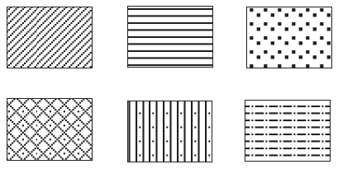
General Rules for Constructing Diagrams
1. Neatness. As already pointed out, diagrams are visual aids for presentation of statistical data and are more appealing and fascinating to the eye and leave a lasting impression on the mind. It is, therefore, imperative that they are made very neat, clean and attractive by proper size and lettering; and the use of
appropriate devices like different colours, different shades (light and dark), dots, dashes, dotted lines, broken lines, dots and dash lines, etc., for filling the in between space of the bars, rectangles, circles, etc.,
and their components. Some of the commonly used devices are given below :

Slide 33
2. Title and Footnotes. As in the case of a good statistical table, each diagram should be given a suitable title to indicate the subject-matter and the various facts depicted in the diagram. The title should be brief, self explanatory, clear and non-ambiguous.
3. Selection of Scale. One of the most important factors in the construction of diagrams is the choice of
an appropriate scale. The same set of numerical data if plotted on different scales may give the diagrams
differing widely in size and at times might lead to wrong and misleading interpretations. Hence, the scale should be selected with great caution. Unfortunately, no hard and fast rules are laid down for the choice of scale.
4. Proportion Between Width and Height. A proper proportion between the dimensions (height and
width) of the diagram should be maintained, consistent with the space available. Here again no hard and fast rules are laid down.
5. Choice of a Diagram. A large number of diagrams (discussed below) are used to present statistical data. The choice of a particular diagram to present a given set of numerical data is not an easy one. It primarily depends on the nature of the data, magnitude of the observations and the type of people for whom the diagrams are meant and requires great amount of expertise, skill and intelligence.

Slide 34
6. Source Note and Number. As in the case of tables, source note, wherever possible should be appended at the bottom of the diagram. This is necessary as, to the learned audience of Statistics, the reliability of the information varies from source to source. Each diagram should also be given a number for ready reference and comparative study.
7. Index. A brief index explaining various types of shades, colours, lines and designs used in the construction of the diagram should be given for clear understanding of the diagram.
8. Simplicity. Lastly, diagrams should be as simple as possible so that they are easily understood even by a layman who does not have any mathematical or statistical background. If too much information is presented in a single complex diagram it will be difficult to grasp and might even become confusing to the
mind. Hence, it is advisable to draw more simple diagrams than one or two complex diagrams.
Types of Diagrams
(1) One-dimensional diagrams viz., line diagrams and bar diagrams.
(2) Two-dimensional diagrams such as rectangles, squares, and circles or pie diagrams.
(3) Three-dimensional diagrams such as cubes, spheres, prisms, cylinders and blocks.
(4) Pictograms.
(5) Cartograms.

Slide 35
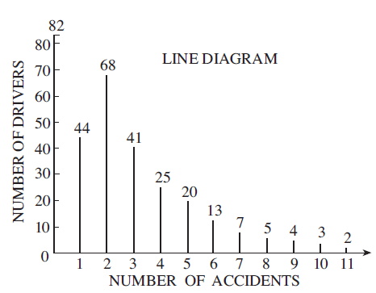
A. LINE DIAGRAM
Example. 4·1. The following data shows the number of accidents sustained by 314 drivers of a public
utility company over a period of five years.
Number of accidents: 0 1 2 3 4 5 6 7 8 9 10 11
Number of drivers : 82 44 68 41 25 20 13 7 5 4 3 2
Represent the data by a line diagram.

Slide 36
B. BAR DIAGRAM
Bar diagrams are one of the easiest and the most commonly used devices of presenting most of the business and economic data
(i) All the bars drawn in a single study should be of uniform (though arbitrary) width depending on the number of bars to be drawn and the space available.
(ii) Proper but uniform spacing should be given between different bars to make the diagram look more attractive and elegant.
(iii) The height (length) of the rectangles or bars are taken proportional to magnitude of the observations, the scale being selected keeping in view the magnitude of the largest observation.
(iv) All the bars should be constructed on the same base line.
(v) It is desirable to write the figures (magnitudes) represented by the bars at the top of the bars to enable the reader to have a precise idea of the value without looking at the scale.
(vi) Bars may be drawn vertically or horizontally. However, in practice, vertical bars are generally used because they give an attractive and appealing get up.
(vii) Wherever possible the bars should be arranged from left to right (from top to bottom in case of horizontal bars) in order of magnitude to give a pleasing effect.

Slide 37
Types of Bar Diagrams. The following are the various types of bar diagrams in common use :
(a) Simple bar diagram.
(b) Sub-divided or component bar diagram.
(c) Percentage bar diagram.
(d) Multiple bar diagram.
(e) Deviation or Bilateral bar diagram.
Example 4·2. The following data relating to the strength of the Indian Merchant Shipping Fleet gives
the Gross Registered Tonnage (GRT) as on 31st December, for different years.
Year : 1961 1966 1971 1975 1976
GRT in ’000 : 901 1,792 2,500 4,464 5,115
Source : Ministry of Shipping and Transport.
Represent the data by suitable bar diagram.

Slide 38
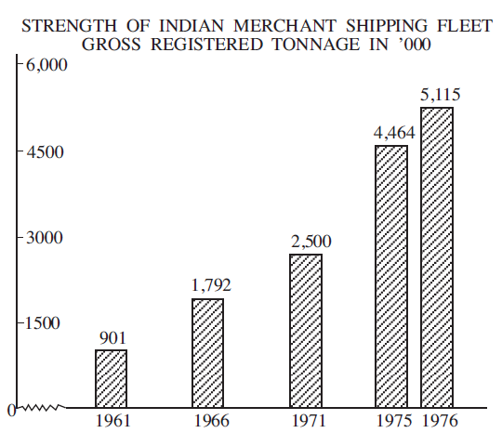

Slide 39
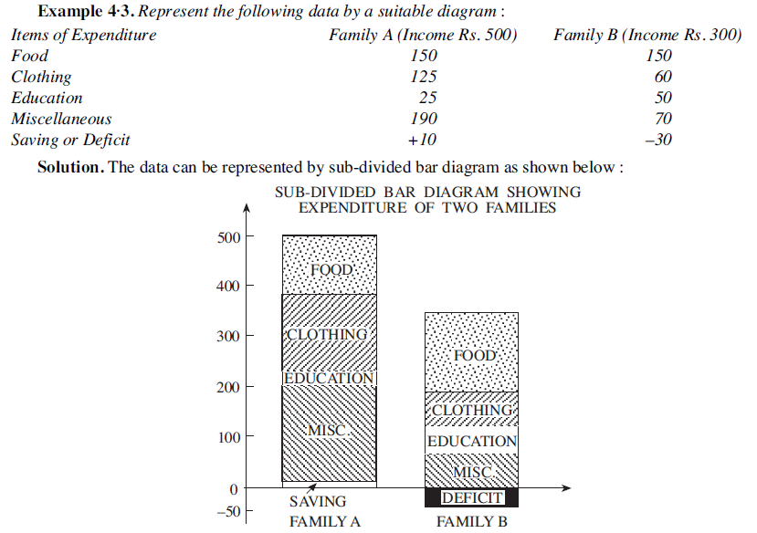

Slide 40
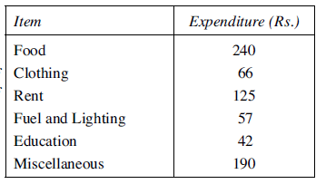
PERCENTAGE BAR DIAGRAM
Example 4·4. The adjoining table gives the break-up of the expenditure of a family on different items of consumption. Draw percentage bar diagram to represent the data.

Slide 41
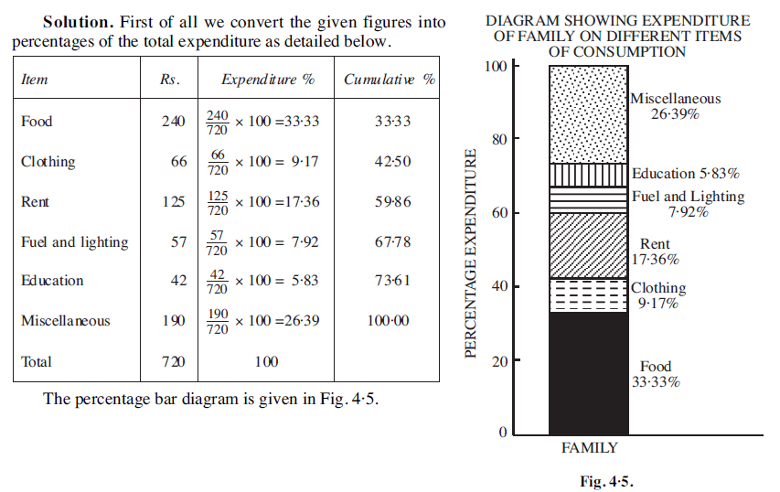

Slide 42
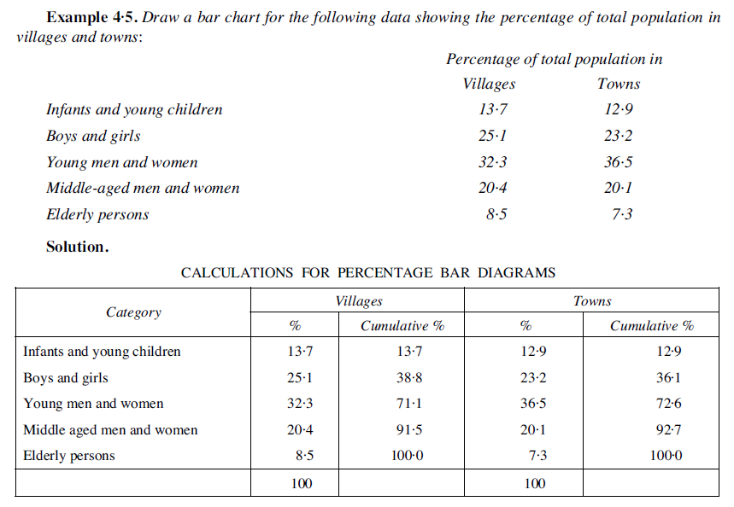

Slide 43
Pie Diagram
Sub-divided and percentage bars are used to represent the total magnitude and its various components, the circle (representing the total) may be divided into various sections or segments viz., sectors representing certain proportion or percentage of the various component parts to the total. Such a sub-divided circle diagram is known as an angular or pie diagram, named so because the various segments resemble slices cut from a pie.
Steps for Construction of Pie Diagram
1. Express each of the component values as a percentage of the respective total.
2. Since the angle at the centre of the circle is 360°, the total magnitude of the various components is taken to be equal to 360° and each component part is to be expressed proportionately in degrees. Since 1 per cent of the total value is equal to 360/100 = 3·6°, the percentage of the component parts obtained in step 1 can be converted to degrees by multiplying each of them by 3·6.
3. Draw a circle of appropriate radius using an appropriate scale depending on the space available. If only one category or characteristic is to be used, the circle may be drawn of any radius. However, if two or more sets of data are to be presented simultaneously for comparative studies, then the radii of the corresponding circles are to be proportional to the square roots of their total magnitudes.

Slide 44
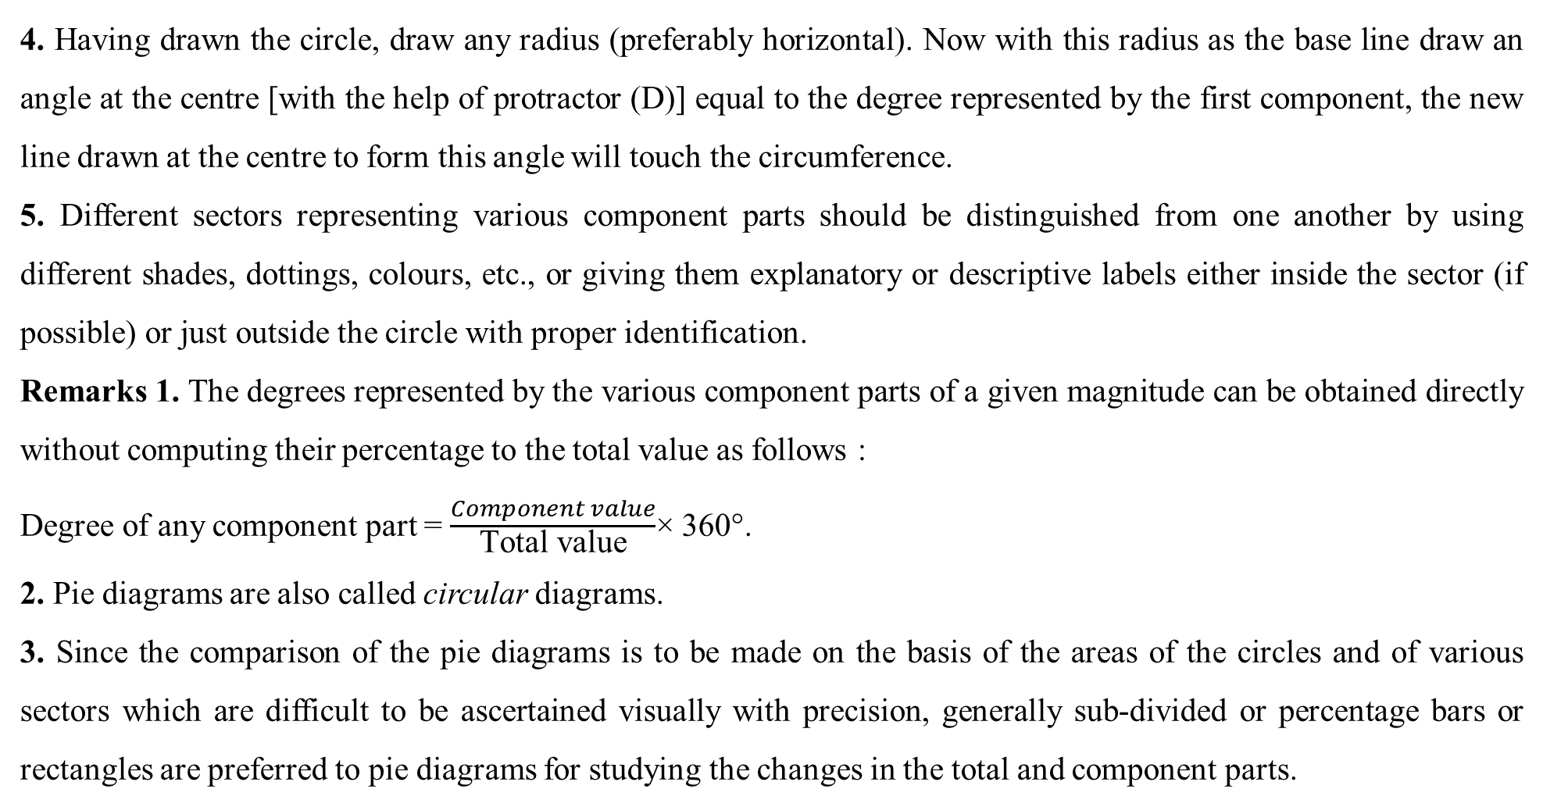
4. Having drawn the circle, draw any radius (preferably horizontal). Now with this radius as the base line draw an angle at the centre [with the help of protractor (D)] equal to the degree represented by the first component, the new line drawn at the centre to form this angle will touch the circumference.
5. Different sectors representing various component parts should be distinguished from one another by using different shades, dottings, colours, etc., or giving them explanatory or descriptive labels either inside the sector (if possible) or just outside the circle with proper identification.
Remarks 1. The degrees represented by the various component parts of a given magnitude can be obtained directly without computing their percentage to the total value as follows :
Degree of any component part = $\frac{Component value}{\text{Total} \text{value}}$× 360°.
2. Pie diagrams are also called circular diagrams.
3. Since the comparison of the pie diagrams is to be made on the basis of the areas of the circles and of various sectors which are difficult to be ascertained visually with precision, generally sub-divided or percentage bars or rectangles are preferred to pie diagrams for studying the changes in the total and component parts.

Slide 45
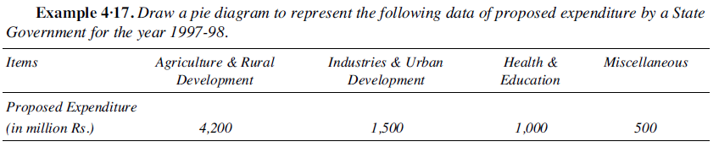
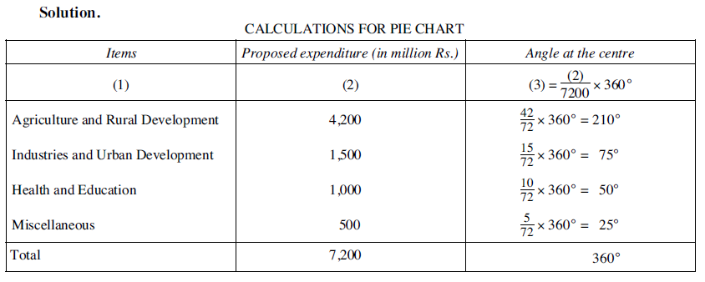

Slide 46
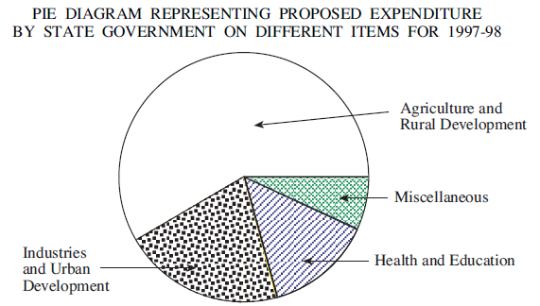

Slide 47
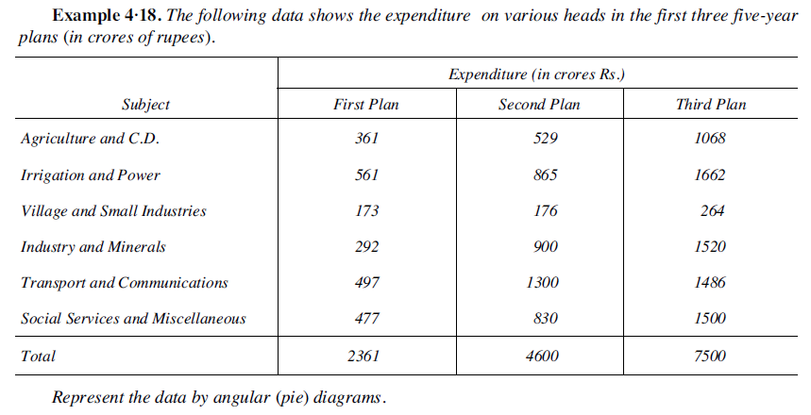

Slide 48
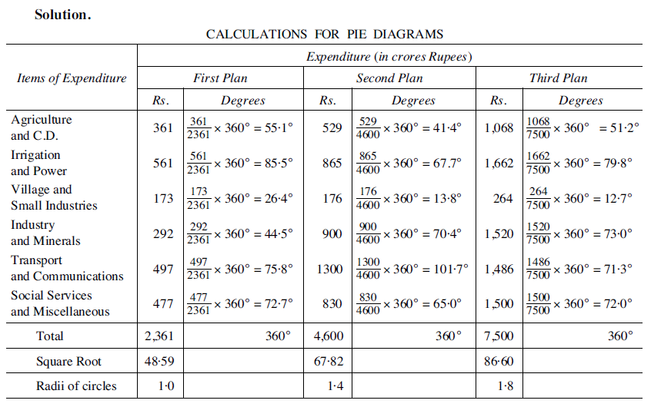

Slide 49
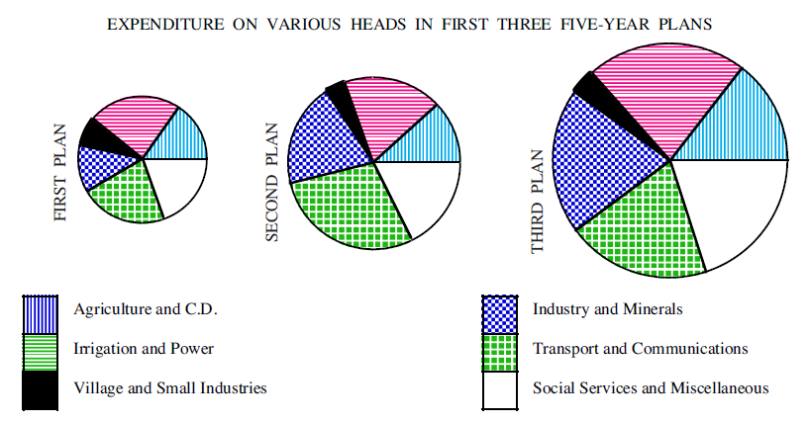

Slide 50
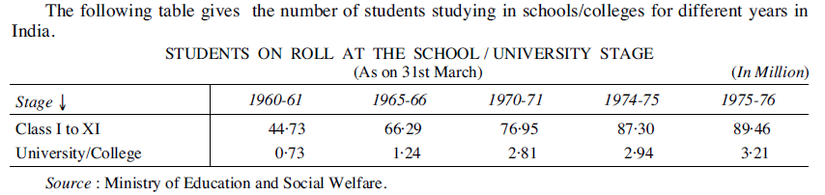
Pictograms
Pictograms is the technique of presenting statistical data through appropriate pictures and is one of the very popular devices particularly when the statistical facts are to be presented to a layman without any mathematical background. In this, the magnitudes of the particular phenomenon under study are presented through appropriate pictures, the number of pictures drawn or the size of the pictures being proportional to the values of the different magnitudes to be presented.

Slide 51
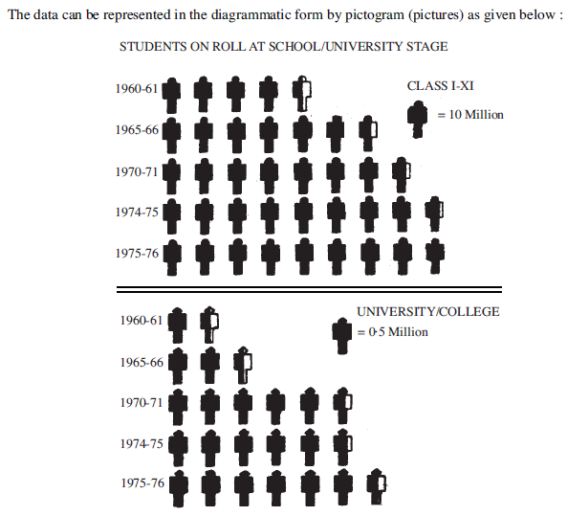

Slide 52
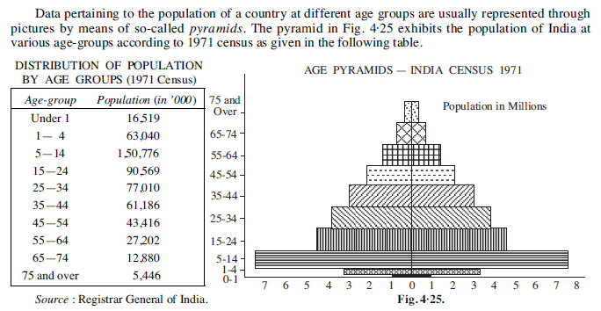

Slide 53
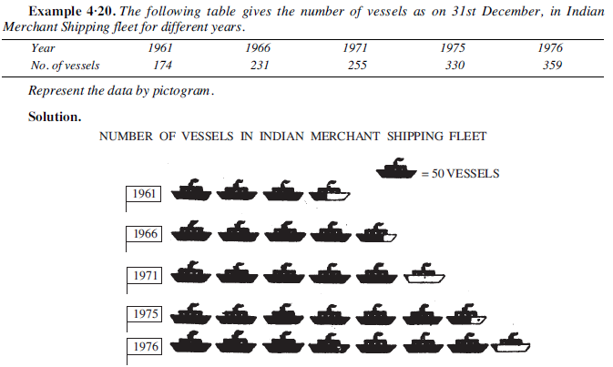

Slide 54
Choice of a Diagram
In the previous sections we have described types of diagrams which can be used to present the given set of numerical data and also discussed briefly their relative merits and demerits. No single diagram is suited for all practical situations. The choice of a particular diagram for visual presentation of a given set of data is not an easy one and requires great skill, intelligence and expertise. The choice will primarily depend upon the nature of the data and the object of presentation, i.e., the type of the audience to whom the diagrams are to be presented and it should be made with utmost care and caution. A wrong or injudicious selection of the diagram will distort the true characteristics of the phenomenon to be presented and might lead to very wrong and misleading interpretations. Some special types of data, viz., the data relating to frequency curves and time series are best represented by means of graphs which we will discuss in the following sections.

Slide 55
GRAPHIC REPRESENTATION OF DATA
Like diagrams, a large number of graphs are used in practice. But they can be broadly classified under the following two heads :
(i) Graphs of Frequency Distributions.
(ii) Graphs of Time Series.
General Rules for Graphing
1. Neatness.
2. Title and Footnote
3. Structural Framework.
4. Scale
5. False Base line
6. Ratio
7. Line Design
8. Sources Note and Number
9. Index
10. Simplicity

Slide 56
False Base line
The fundamental principle of drawing graph is that the vertical scale must start with zero. If the fluctuations in the values of the dependent variable (to be shown along Y-axis) are very small relative to their magnitudes, and if the minimum of these values is very distant (far greater) from zero, the point of origin, then for an effective portrayal of these fluctuations the vertical scale is stretched by using false base line. In such a situation the vertical scale is broken and the space between the origin ‘O’ and the minimum value (or some convenient value near that) of the dependent variable is omitted by drawing two zig-zag horizontal lines above the base line. The scale along Y-axis is then framed accordingly. False base line technique is quite extensively used for magnifying the minor fluctuations in a time series data.

Slide 57
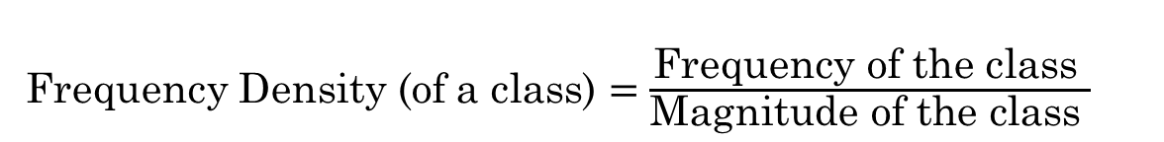
Graphs of Frequency Distributions
The most commonly used graphs for charting a frequency distribution for the general understanding of the details of the data are :
(A) Histogram. (B) Frequency Polygon. (C) Frequency Curve. (D) “Ogive” or Cumulative Frequency Curve.
A. HISTOGRAM
Case (i) Histogram with equal classes.
Case (ii) Histogram with unequal classes
Frequency Density (of a class) $=\frac{\text{Frequency} \text{of} \text{the} \text{class} }{\text{Magnitude} \text{of} \text{the} \text{class} }$
Example 4·21. Draw histogram for the following frequency distribution.
Variable : 10—20 20—30 30—40 40—50 50—60 60—70 70—80
Frequency : 12 30 35 65 45 25 18

Slide 58
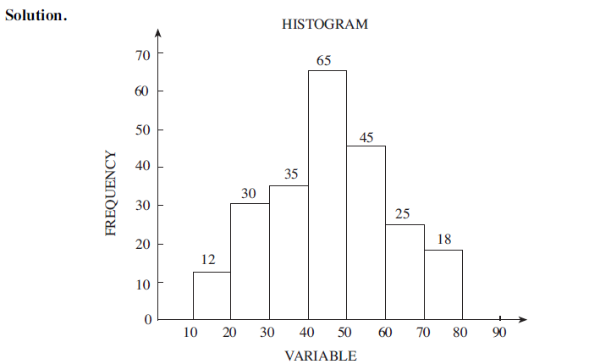

Slide 59
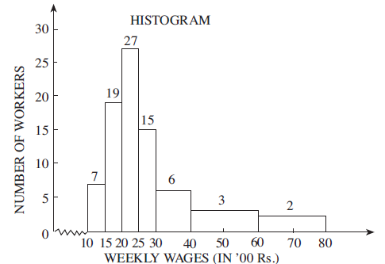
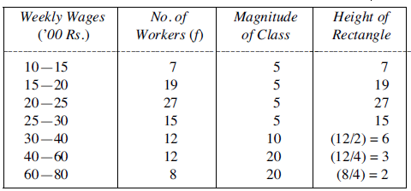
Example 4·22. Represent the following data by means of a histogram.
Weekly Wages (’00 Rs.) : 10—15 15—20 20—25 25—30 30—40 40—60 60—80
No. of Workers : 7 19 27 15 12 12 8

Slide 60
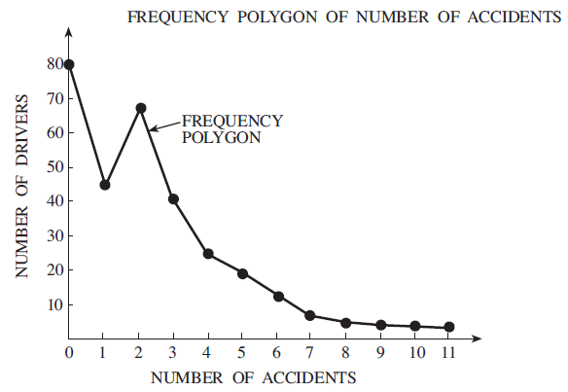
B. FREQUENCY POLYGON
Case (i) From Histogram.
Case (ii) Without Constructing Histogram.
Example 4·23. The following data show the number of accidents sustained by 313 drivers of a public
utility company over a period of 5 years.
Number of accidents : 0 1 2 3 4 5 6 7 8 9 10 11
Number of drivers 80 44 68 41 25 20 13 7 5 4 3 2
Draw the frequency polygon.

Slide 61
Example 4·24. The following table gives the frequency distribution of the weekly wages (in ’00 Rs.) of
100 workers in a factory.
Weekly Wages (’00 Rs.) : 20—24 25—29 30—34 35—39 40—44 45—49 50—54 55—59 60—64 Total
Number of Workers 4 5 12 23 31 10 8 5 2 100
Draw the histogram and frequency polygon of the distribution.
Solution:
Weekly Wages (’00 Rs.) : 19·5—24·5 24·5—29·5 29·5—34·5 34·5—39·5 39·5—44·5 44·5—49·5 49·5—54·5
Number of Workers (f): 4 5 12 23 31 10 8
54·5— 59·5 59·5—64·5
5 2

Slide 62
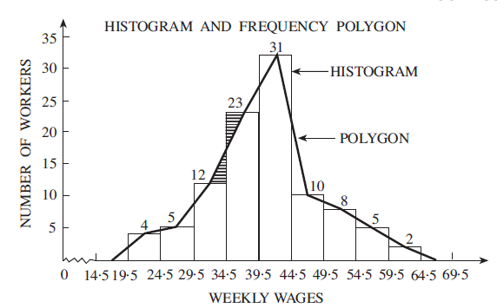

Slide 63
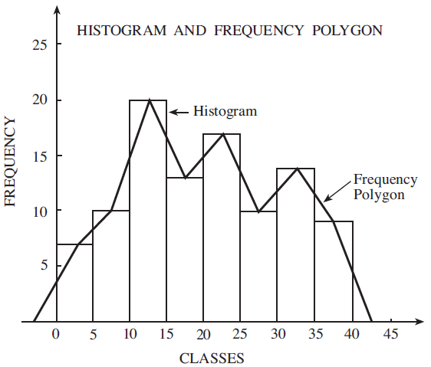
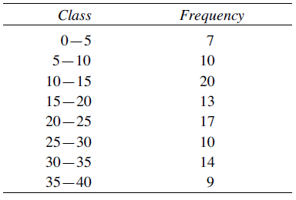
Example 4·25. Draw the histogram and frequency polygon for the following frequency distribution.
Mid-value of class interval : 2·5 7·5 12·5 17·5 22·5 27·5 32·5 37·5
Frequency : 7 10 20 13 17 10 14 9

Slide 64
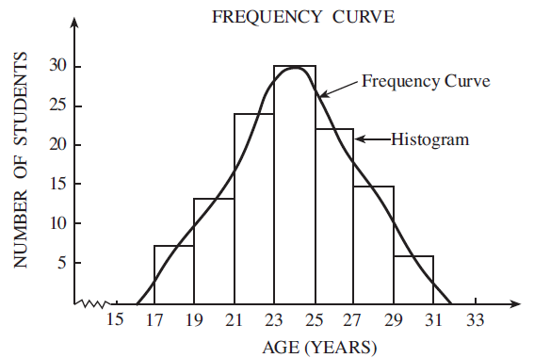
C. FREQUENCY CURVE
In general, frequency curves should be attempted
(i) for frequency distribution based on the samples, and
(ii) when the distribution is continuous.
Example 4·26. Draw a frequency curve for the following distribution :
Age (Yrs.) : 17—19 19—21 21—23 23—25 25—27 27—29 29—31
No. of Students : 7 13 24 30 22 15 6

Slide 65
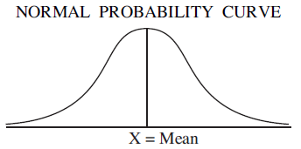
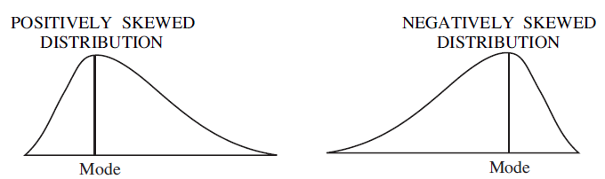
The following hypothetical distribution of marks in a test will give a symmetrical frequency distribution.
Marks : 0—10 10—20 20—30 30—40 40—50 50—60 60—70 70—80 80—90
Frequency : 40 70 120 160 180 160 120 70 40
If the data are presented graphically, we shall obtain a frequency curve which is symmetrical.

Slide 66
D. OGIVE OR CUMULATIVE FREQUENCY CURVE
Ogive, pronounced as ojive, is a graphic presentation of the cumulative frequency (c.f.) distribution of continuous variable. It consists in plotting the c.f. (along the Y-axis) against the class boundaries (along X-axis). Since there are two types of cumulative frequency distributions viz., ‘less than’ c.f. and ‘more than’ c.f. we have accordingly two types of ogives, viz.,
(i) ‘Less than’ ogive.
(ii) ‘More than’ ogive.
‘Less Than’ Ogive. This consists in plotting the ‘less than’ cumulative frequencies against the upper class boundaries of the respective classes. The points so obtained are joined by a smooth freehand curve to give ‘less than’ ogive. Obviously, ‘less than’ ogive is an increasing curve, sloping upwards from left to right and has the shape of an elongated S.
‘More Than’ Ogive. Similarly, in ‘more than’ ogive, the ‘more than’ cumulative frequencies are plotted against the lower class boundaries of the respective classes. The points so obtained are joined by a smooth freehand curve to give ‘more than’ ogive. ‘More than’ ogive is a decreasing curve and slopes downwards from left to right and has the shape of an elongated S, upside down.

Slide 67
Example 4·27. Draw a less than cumulative frequency curve for the following data and find from the
graph the value of seventh decile.
Monthly income No. of workers Monthly income No. of workers
0—100 12 500—600 20
100—200 28 600—700 20
200—300 35 700—800 17
300—400 65 800—900 13
400—500 30 900—1000 10

Slide 68
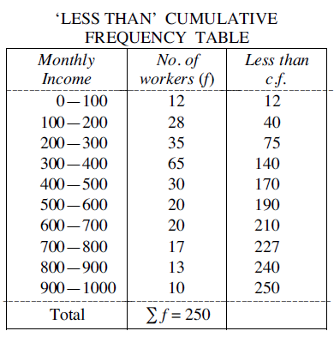
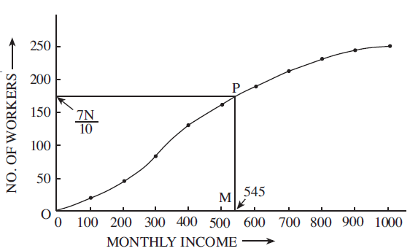

Slide 69
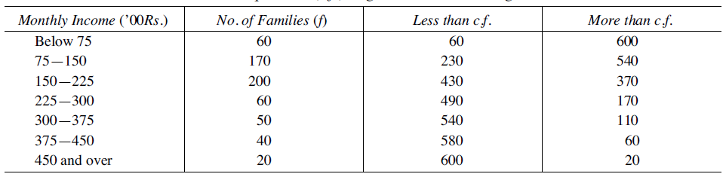
Example 4·28. The following table gives the distribution of monthly income of 600 families in a certain city.
Monthly Income (’00 Rs.) Below 75 75—150 150—225 225—300 300—375 375—450 450 and over
No. of Families 60 170 200 60 50 40 20
Draw a ‘less than’ and a ‘more than’ ogive curve for the above data on the same graph and from these read the median income.

Slide 70
